Slide 1
Digital Portfolio
STUDENT NAME: SANDIYA M
REGISTER NO AND NMID: 20324U09072 CC515E5E6CE27F2B1D143B87CC6F95A4
DEPARTMENT: BCA
COLLEGE: DR.M.G.R.CHOCKALINGAM ARTS COLLEGE THIRUVALUVAR UNIVERSITY

Slide 2
PROJECT TITLE
STUDENT DIGITAL PORTFOLIO USING FRONT END WEB DEVELOPMENT (HTML, CSS & JAVASCRIPT)

Slide 3


AGENDA
Problem Statement
Project Overview
End Users
Tools and Technologies
Portfolio design and Layout
Features and Functionality
Results and Screenshots
Conclusion
Github Link
3/21/2024 Annual Review

Slide 4

PROBLEM STATEMENT
The problem is to design and develop a Digital Portfolio Website that provides a centralized platform where an individual can showcase personal details, skills, academic background, projects, and achievements in an interactive and professional manner. The system should be:
Accessible – available online from anywhere.
User-friendly – simple navigation and responsive design for mobile and desktop.
Customizable – allowing the user to update information easily.
Engaging – with interactive features such as smooth scrolling, animations, and contact forms.

Slide 5

PROJECT OVERVIEW
The portfolio will be developed using HTML, CSS, and JavaScript to ensure responsiveness, smooth navigation, and an engaging user experience. The website will include sections such as:
Home Section – introduction and personal tagline.
About Section – brief background and career goals.
Projects Section – details of academic and professional work.
Contact Section – form for visitors to reach out.

Slide 6

WHO ARE THE END USERS?
The end users of the Digital Portfolio are individuals and groups who interact with the portfolio for different purposes:
Students & Job Seekers – They use the digital portfolio to present their skills, qualifications, and projects to potential employers in a professional format.
Professionals & Freelancers – They maintain their digital portfolio as a showcase of their work, achievements, and expertise to attract clients and career opportunities.
Employers & Recruiters –ors – They access the portfolio to evaluate a candidate’s skills, background, and suitability for a job role.
Clients & Collaborat They use the portfolio to assess the professional capabilities of an individual before offering projects or partnerships

Slide 7

TOOLS AND TECHNIQUES
Tools (Software & Technologies used)
HTML5 (HyperText Markup Language) – Used to design the basic structure and content of the portfolio (headings, text, images, links, forms).
CSS3 (Cascading Style Sheets) – Used for styling, layout design, colors, fonts, responsiveness, and overall visual presentation.
JavaScript – Provides interactivity and functionality (form validation, smooth scrolling, animations, dynamic elements).
Code Editor (e.g., VS Code / Sublime Text) – A development environment used to write, edit, and debug the code.
Web Browser (e.g., Chrome, Edge, Firefox) – Used to run and test the portfolio website.
Version Control (Git/GitHub) (optional but recommended) – Helps in tracking changes, backup, and sharing the project.

Slide 8
PORTFOLIO DESIGN AND LAYOUT
,THE and user-friendly. The design and layout of a digital portfolio refers to the visual structure, organization, and presentation of its contents. A well-designed portfolio ensures that information such as personal details, skills, projects, and contact information is easy to navigate, visually appealing
Key Elements of Design & Layout
Navigation Structure – A clear menu (Home, About, Projects, Contact) that allows users to quickly access different sections.
Visual Hierarchy – Using headings, colors, and font sizes to highlight important information like the user’s name, title, and featured projects.
Responsive Layout – The portfolio adjusts seamlessly across devices (desktop, tablet, and mobile).
Section-Based Design – Information is divided into distinct sections (Hero, About, Projects, Contact), making it easier for visitors to browse.
Consistency – Uniform use of fonts, colors, and spacing throughout the portfolio to maintain professionalism.
Interactive Elements – Smooth scrolling, hover effects, animations, and contact forms that engage visitors.
8

Slide 9
FEATURES AND FUNCTIONALITY
The features of a digital portfolio refer to the visible components and design elements that enhance the look and feel of the website. The functionality refers to the interactive and operational aspects that make the website useful and responsive for end users.
Key Features
Homepage / Hero Section – Attractive introduction with name, tagline, and a call-to-action.
About Section – Personal information, skills, and career goals.
Projects Section – Display of past works, academic projects, or professional achievements.
Contact Section – Form for visitors to send messages directly.
Navigation Bar – Easy access to different sections of the portfolio.
Responsive Design – Works on desktops, tablets, and smartphones.
Key Functionalities
Smooth Scrolling – Seamless transition when navigating between sections.
Form Handling – Collecting user details and sending confirmation/feedback.
Hover Effects & Animations – Interactive elements that improve user experience.
Project Highlighting – Enlarging or animating project cards on hover for emphasis.
Dynamic Interactivity – JavaScript-powered features like alerts, form validation, and button actions.

Slide 10

RESULTS AND SCREENSHOTS
The results of the Digital Portfolio project represent the successful implementation of the website according to the defined objectives. It demonstrates how the portfolio provides a structured platform for showcasing personal details, skills, and projects in an interactive and visually appealing way. The results validate that the system is functional, user-friendly, responsive, and accessible across devices.
Screenshots
The screenshots are visual evidence of the developed digital portfolio. They highlight the design and functionality of different sections such as:
Homepage/Hero Section – introduction with name and tagline.
About Section – user details and background.
Projects Section – display of academic/professional work.
Contact Section – working form for communication.
Navigation Menu – smooth transitions between sections.
These screenshots provide proof of the project’s completion and illustrate how the design and features come together to create the final working system.
3/21/2024 Annual Review
10

Slide 11
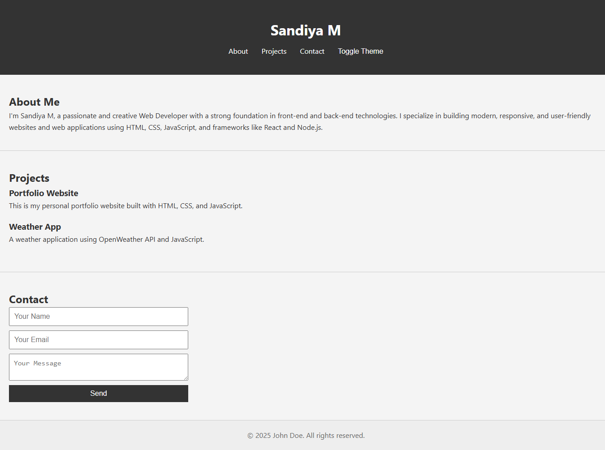
SCREENSHOT

Slide 12
CONCLUSION
The Digital Portfolio Project successfully demonstrates how a personal portfolio can be designed and developed using HTML, CSS, and JavaScript. The project achieves its objective of creating an interactive, user-friendly, and responsive platform for showcasing an individual’s profile, skills, and projects.
This system provides a modern alternative to traditional resumes by offering greater accessibility, visual appeal, and interactivity. It not only helps students and professionals present their achievements effectively but also provides employers and clients with an engaging way to evaluate candidates.
In conclusion, the project proves that a well-structured digital portfolio enhances professional visibility, improves opportunities, and serves as a valuable tool in today’s digital world.
12

Slide 13
PROJECT LINK : https://github.com/sandiya-m-01/digital-portfolio-1.git
OUTUPUT LINK : https://sandiya-m-01.github.io/digital-portfolio-1/

